Slide 1

Fast practical lattice reduction through iterated compression
Keegan Ryan and Nadia Heninger

Slide 2
The “Two Faces” of lattice reduction [NS01]
Exact lattice reduction is HARD
Approximate reduction is EASY
(polynomial time)
Post-quantum cryptography
Kyber, NTRU, SABER, Falcon
LWE-based FHE
RSA partial factorization
ECDSA nonce leakage
ECHNP and MIHNP
Approximate GCD
Gentry-Szydlo algorithm
Merkle-Hellman knapsacks
NTRU, integer, and ideal FHE
Polynomial factorization
Integer relation finding
Fast arithmetic in number fields

Slide 3
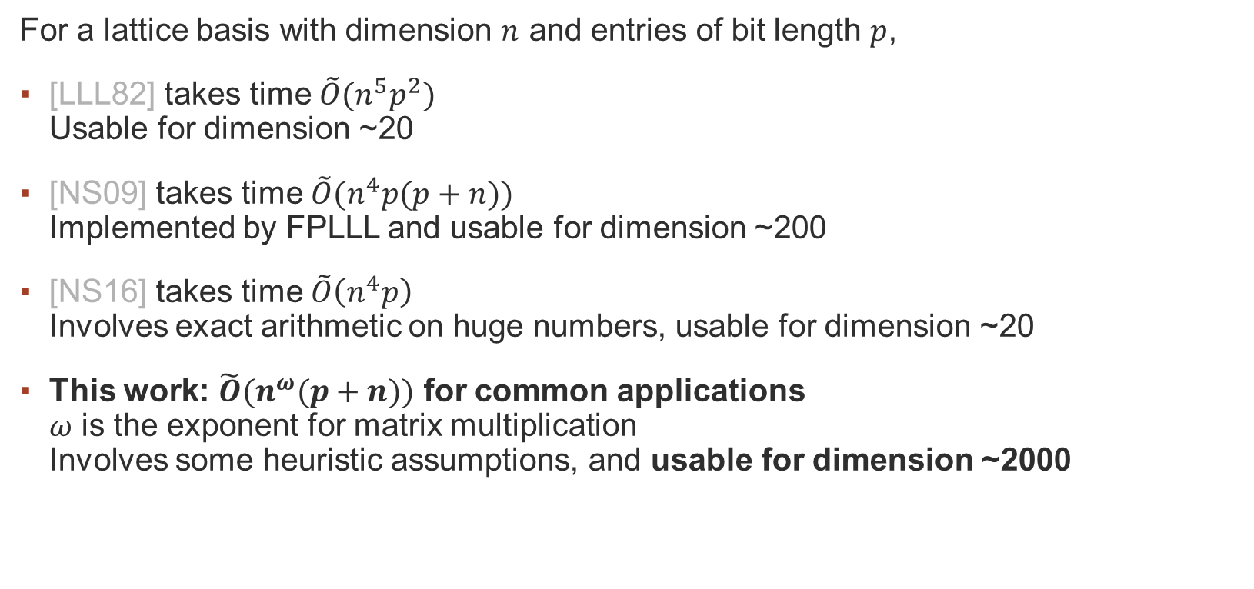
Lattice reduction is a cryptanalytic bottleneck
For a lattice basis with dimension $n$ and entries of bit length $p$,
[LLL82] takes time $\tilde{O}(n^{5}p^{2})$ Usable for dimension ~20
[NS09] takes time $\tilde{O}(n^{4}p(p+n))$ Implemented by FPLLL and usable for dimension ~200
[NS16] takes time $\tilde{O}\left(n^{4}p\right)$ Involves exact arithmetic on huge numbers, usable for dimension ~20
This work: $\tilde{O}(n^{ω}(p+n))$ for common applications $ω$ is the exponent for matrix multiplication Involves some heuristic assumptions, and usable for dimension ~2000

Slide 4
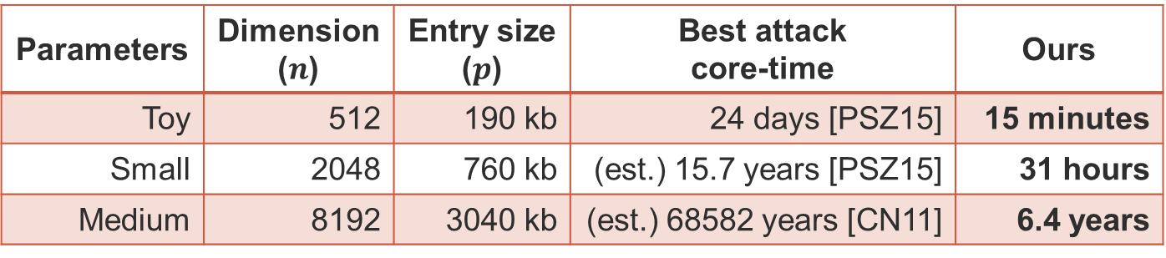
Example: Gentry-Halevi FHE [GH11]
Most Gentry-Halevi public challenges for FHE can be broken with LLL reduction.
In practice, this is still too expensive.
Parameters | Dimension ($n$) | Entry size ($p$) | Best attack core-time | Ours
Toy | 512 | 190 kb | 24 days [PSZ15] | 15 minutes
Small | 2048 | 760 kb | (est.) 15.7 years [PSZ15] | 31 hours
Medium | 8192 | 3040 kb | (est.) 68582 years [CN11] | 6.4 years

Slide 5
Example: Gentry-Halevi FHE [GH11]
Most Gentry-Halevi public challenges for FHE can be broken with LLL reduction.
In practice, this is still too expensive.
Parameters
Dimension
Entry size
Best attack
Ours
(
)
(
)
core
-
time
Toy
512
190 kb
24 days [PSZ15]
15 minutes
Small
2048
760 kb
(est.) 15.7 years [PSZ15]
31 hours
Medium
8192
3040 kb
(est.) 68582 years [CN11]
6.4 years
Main challenge solutions
Toy: 212 368 26 507 14 391 295 226 286 473 64 481 342 109 92
Small: 201 216 186 242 353 55 335 420 104 13 299 262 510 414 239
Medium: 137 215 285 520 251 145 157 205 510 389 110 38 203 248 116

Slide 6
Improving lattice reduction

Slide 7
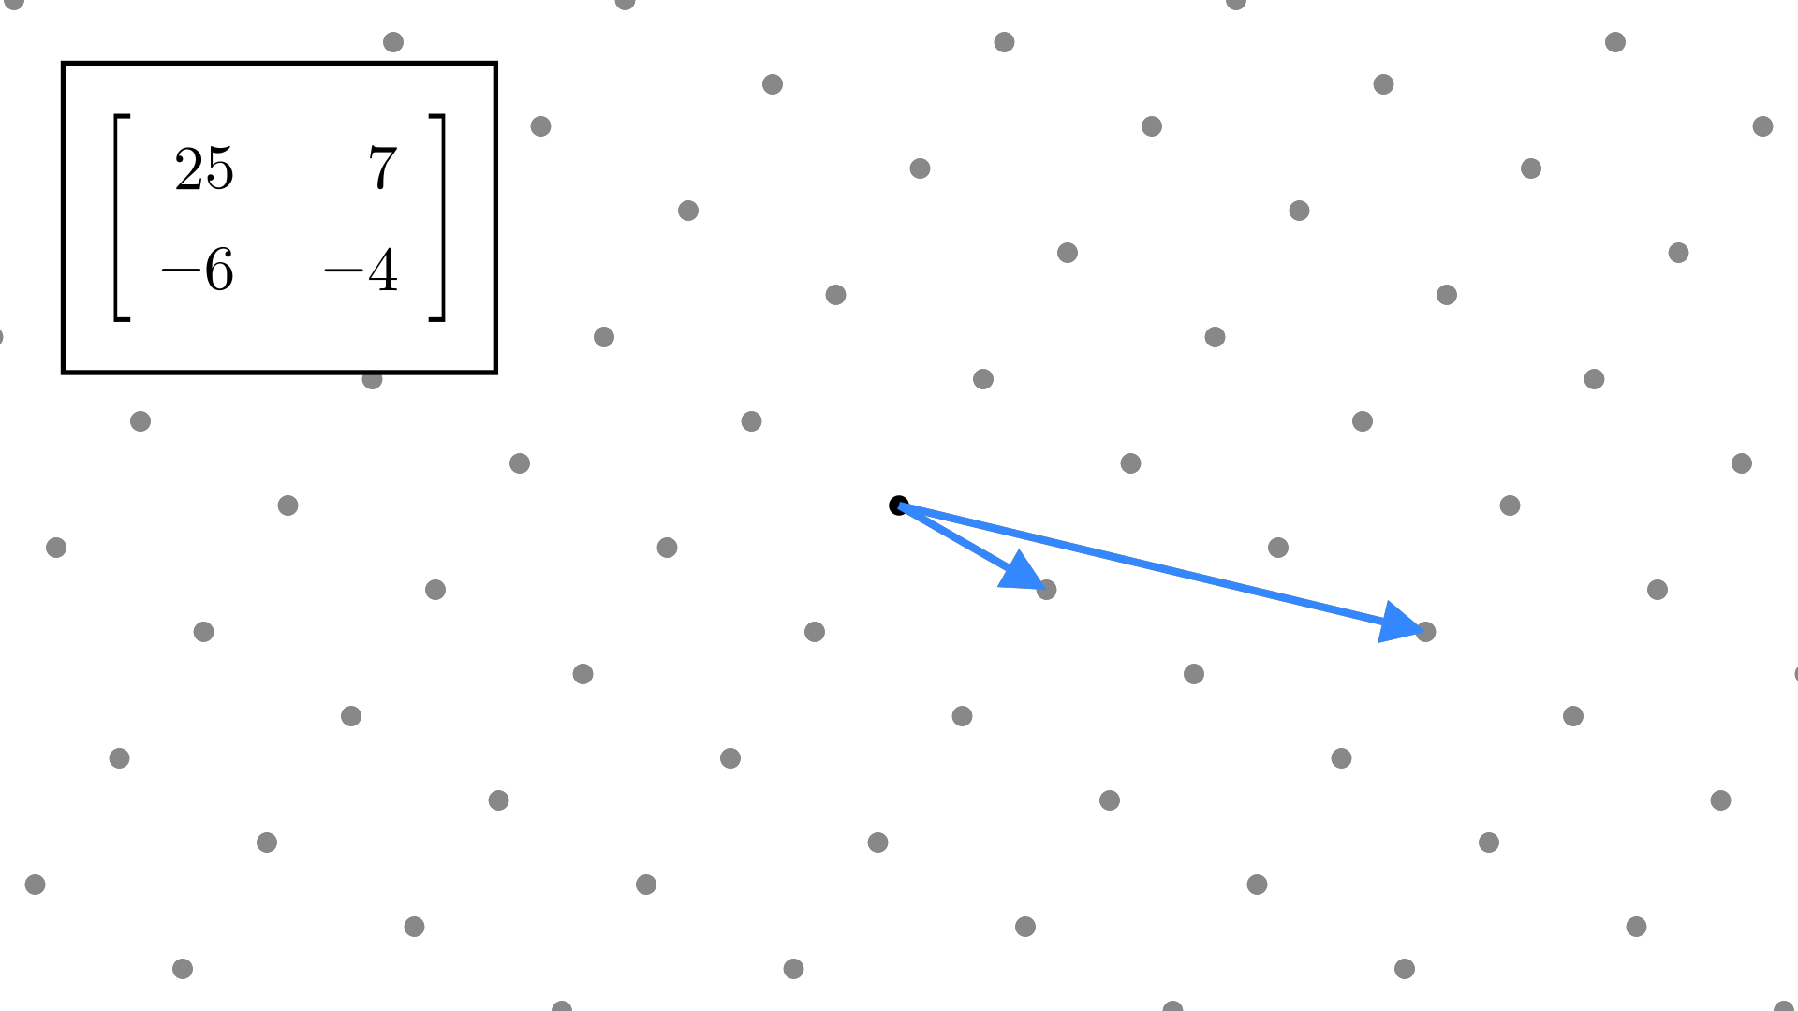
Lattices have many bases

Slide 8
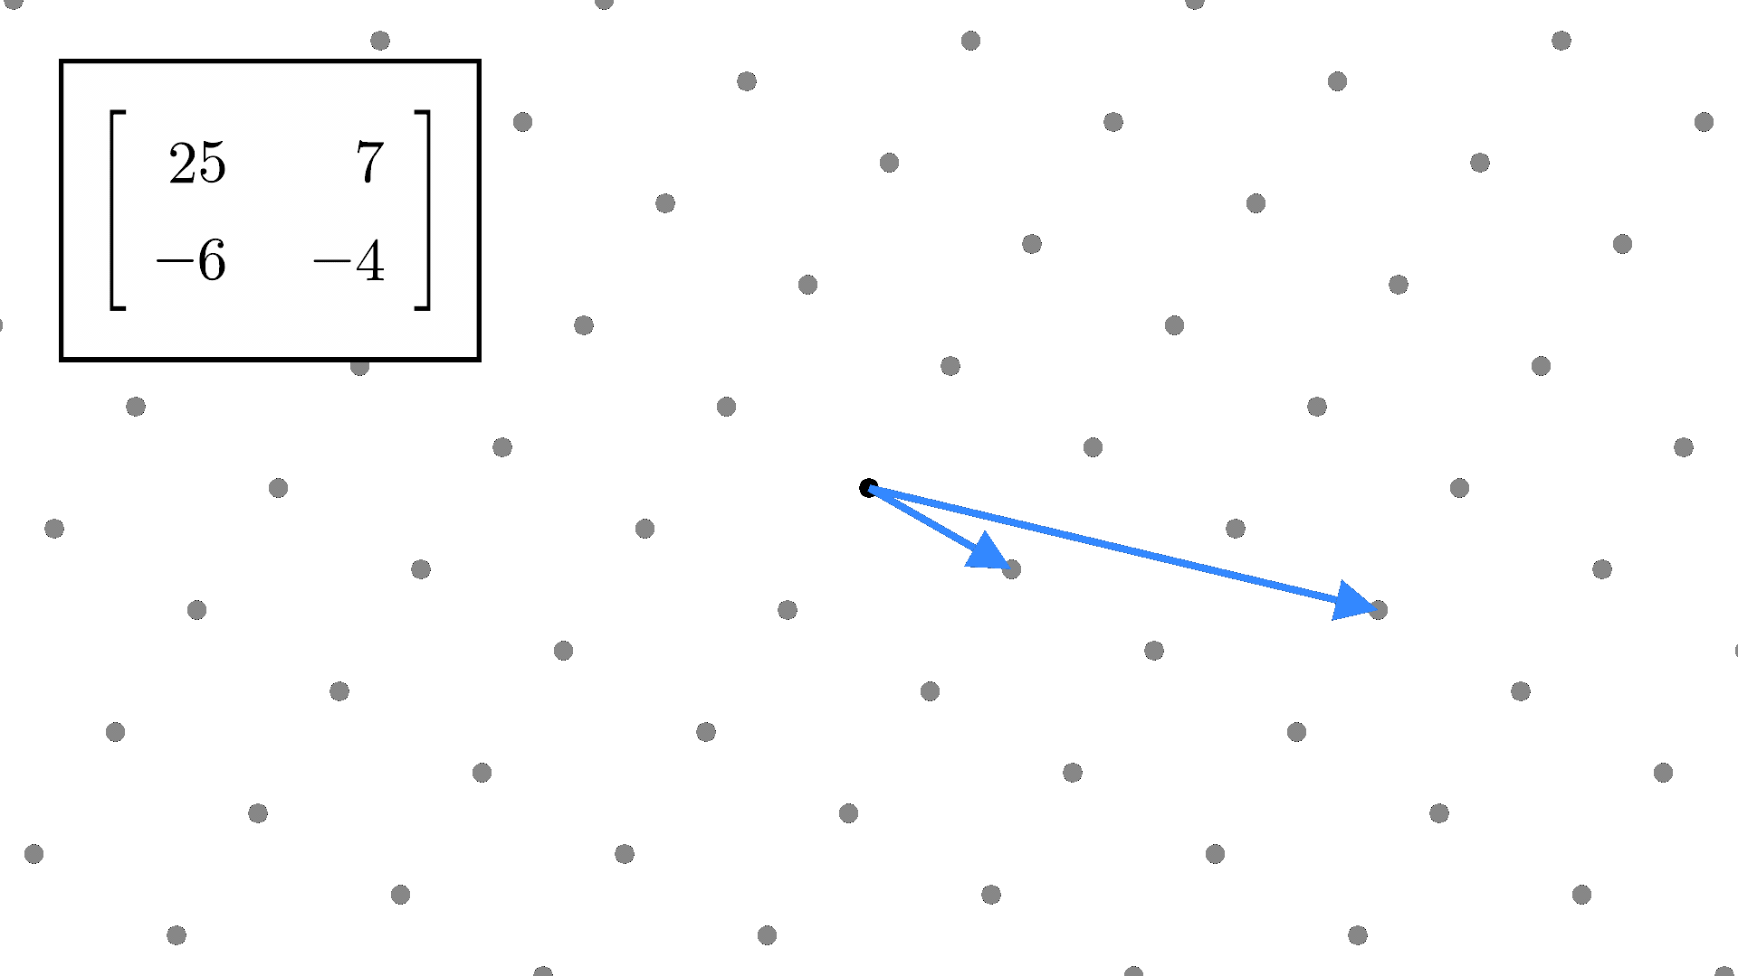
Lattices have many bases

Slide 9
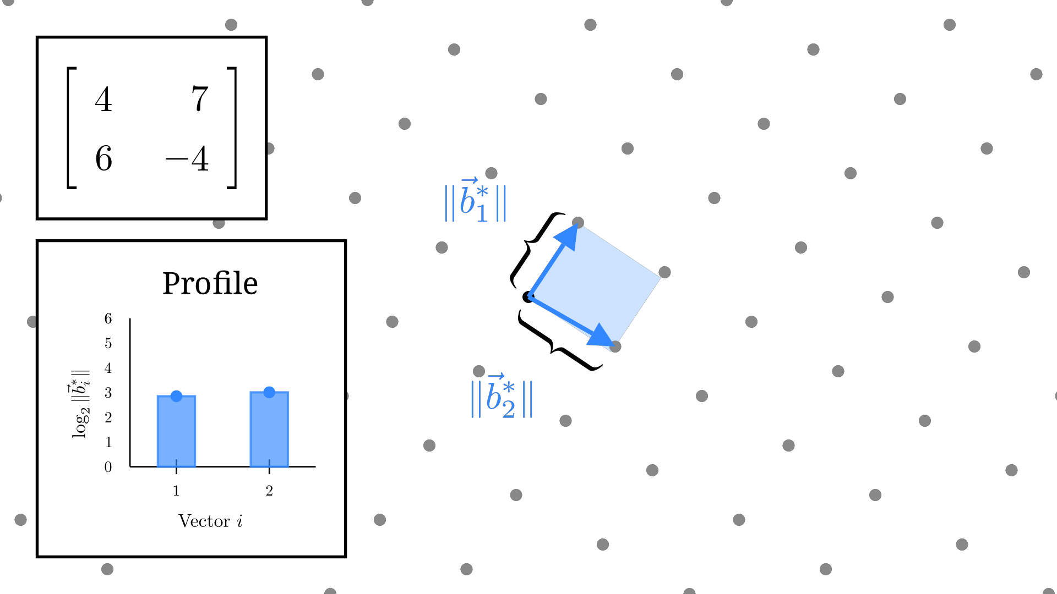
“Good” bases are nearly orthogonal

Slide 10
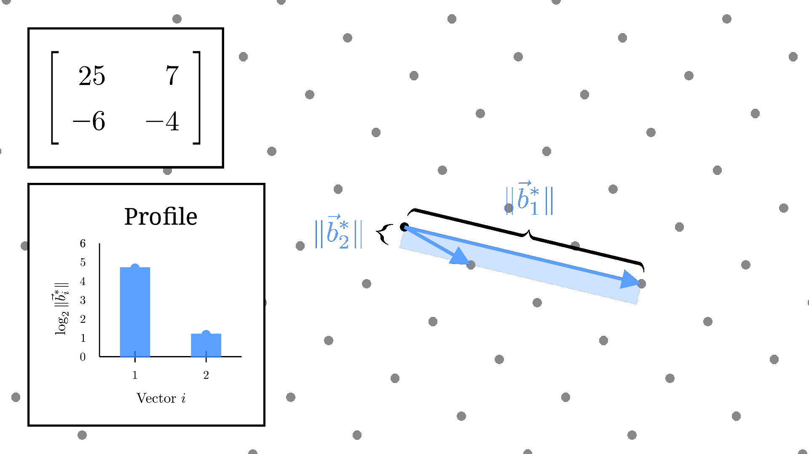
“Good” bases are nearly orthogonal

Slide 11
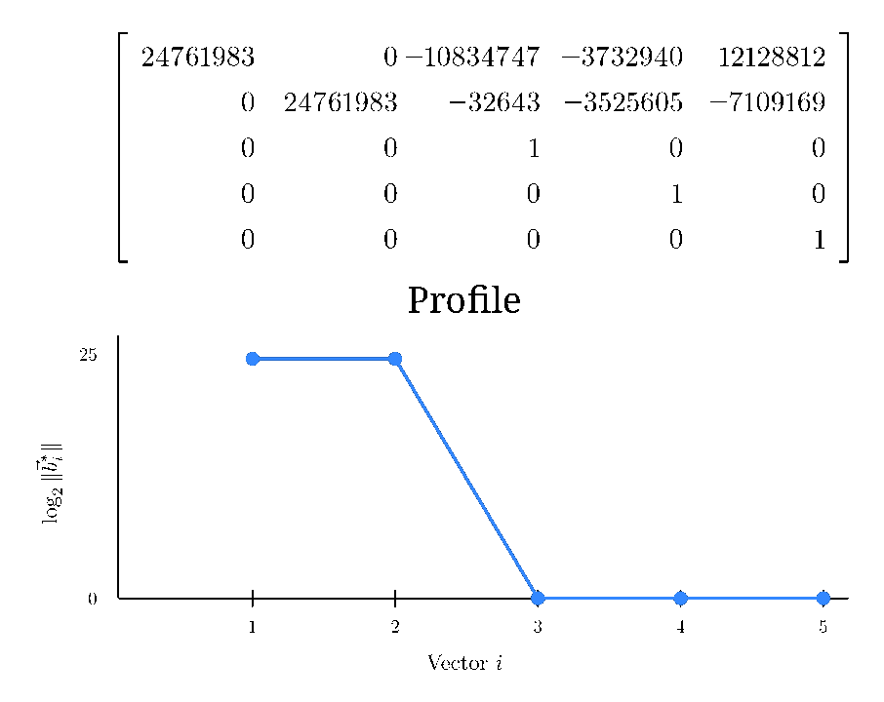
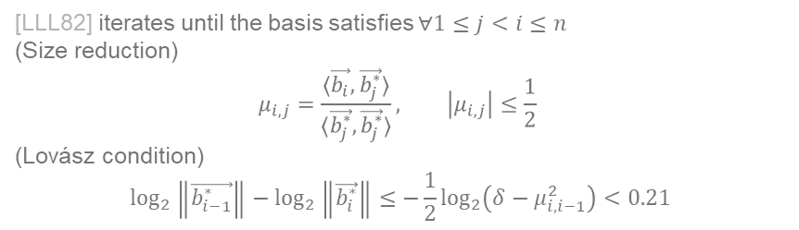
LLL reduction finds a good basis
[LLL82] iterates until the basis satisfies $∀1≤j<i≤n$
(Size reduction)
$$μ_{i,j}=\frac{⟨\vec{b_{i}},\vec{b_{j}^{∗}}⟩}{⟨\vec{b_{j}^{∗}},\vec{b_{j}^{∗}}⟩}, \left|μ_{i,j}\right|≤\frac{1}{2}$$
(Lovász condition)
$$\log_{2}\left\|\vec{b_{i−1}^{∗}}\right\|−\log_{2}\left\|\vec{b_{i}^{∗}}\right\|≤−\frac{1}{2}\log_{2}\left(δ−μ_{i,i−1}^{2}\right)<0.21$$
Lovász condition:
There are no large decreases between successive elements in the profile.

Slide 12
Fast lattice reduction strategies
Two main strategies improve algorithm complexity:
Recursion [KS01,NS16]
Limit the number of full-dimension GSO computations by recursively reducing sublattices of smaller dimension.
Precision management [NS09]
Replace large values in GSO computation with arbitrary-precision floating-point numbers.
Historically, these strategies were mutually exclusive. A fast lattice reduction algorithm should combine both.

Slide 13
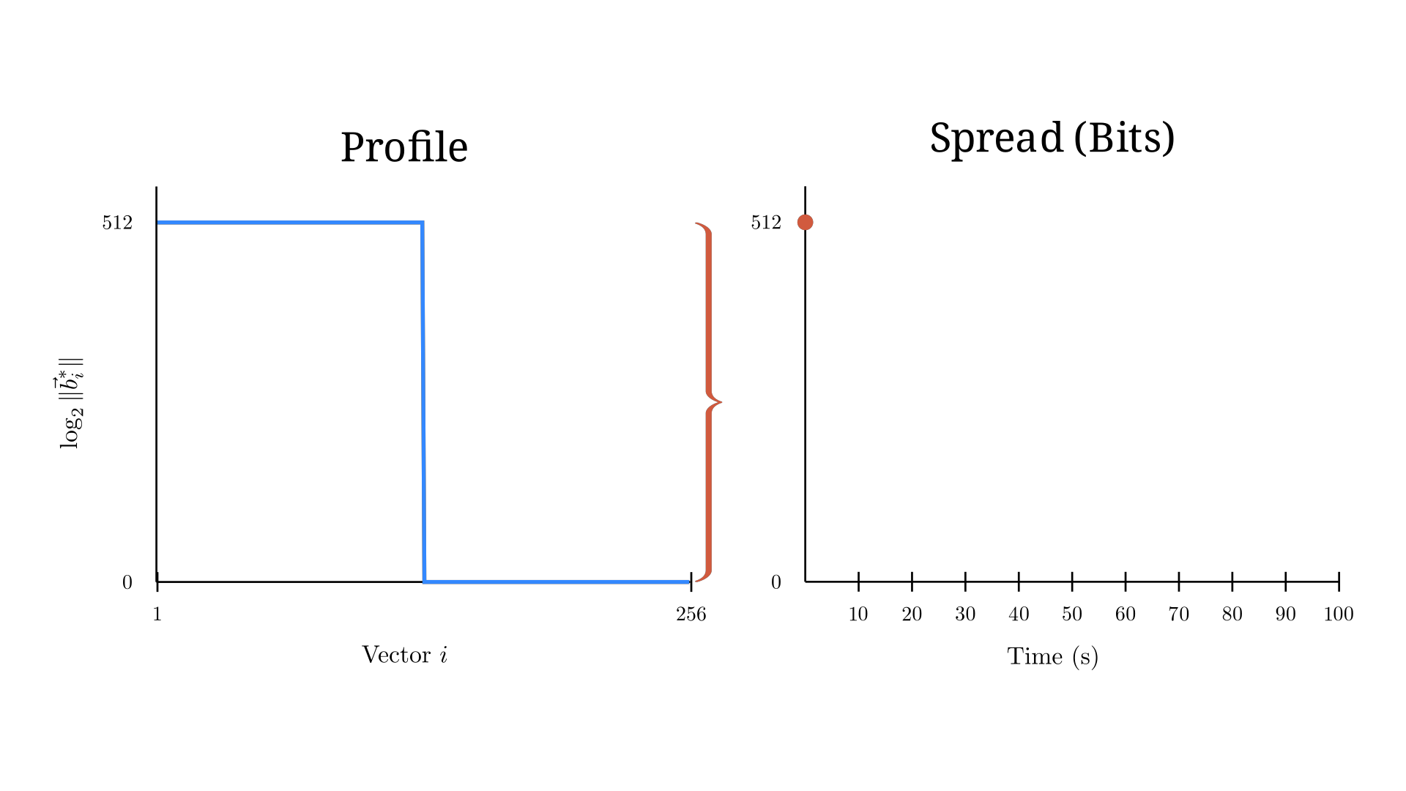
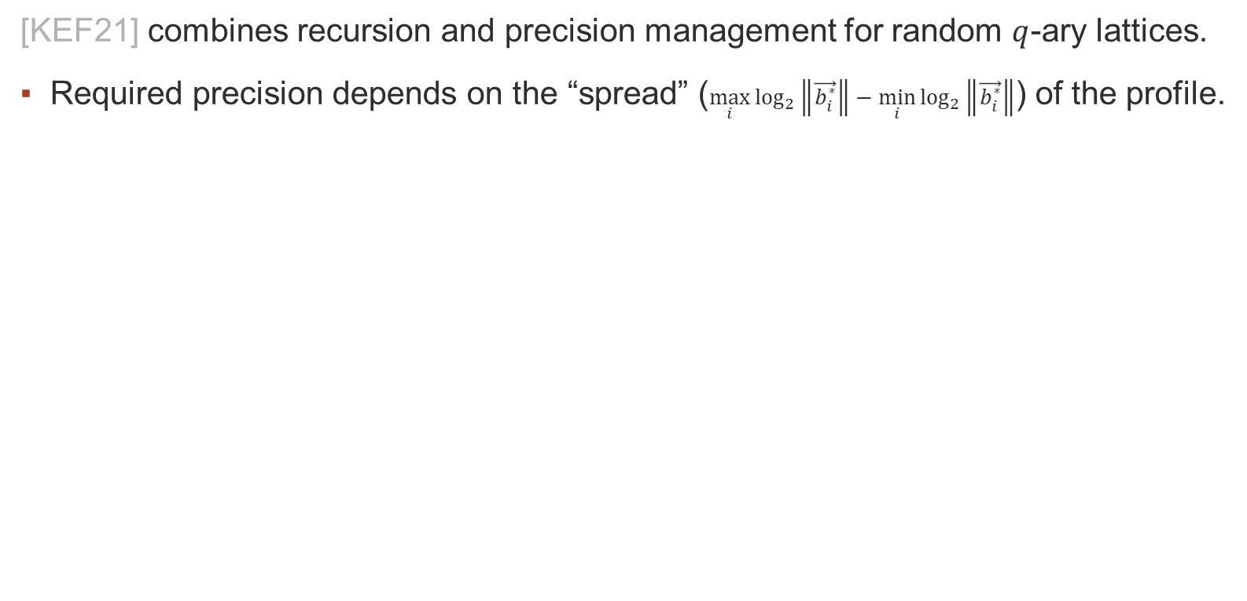

Towards faster lattice reduction [KEF21]
[KEF21] combines recursion and precision management for random $q$-ary lattices.
Required precision depends on the “spread” ($\max_{i}{\log_{2}\left\|\vec{b_{i}^{∗}}\right\|}−\min_{i}{\log_{2}\left\|\vec{b_{i}^{∗}}\right\|}$) of the profile.
Random $q$-ary lattice

Slide 14
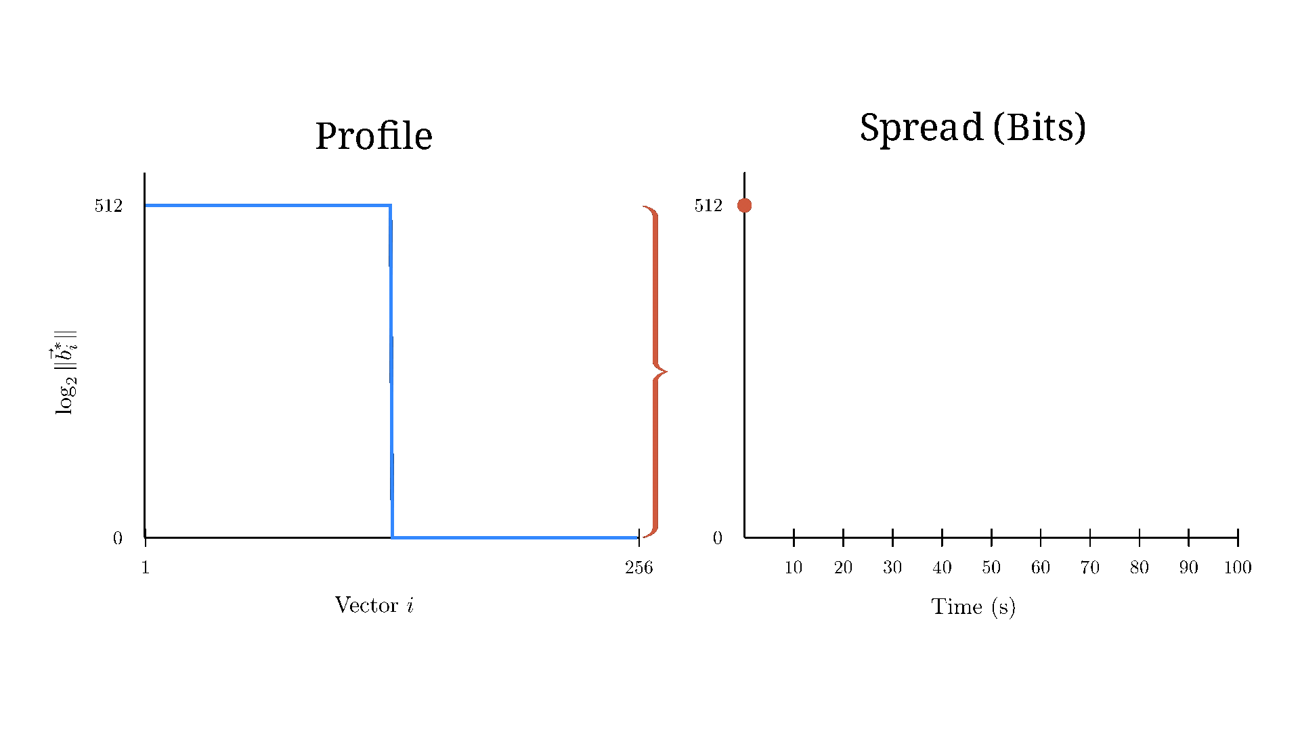
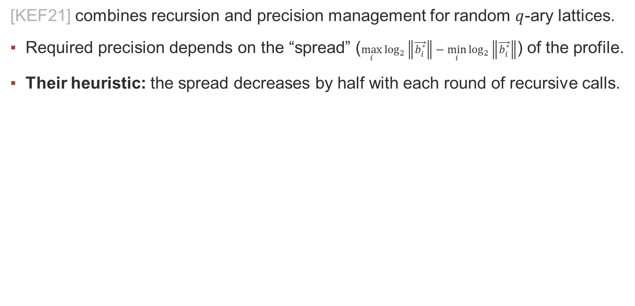
Towards faster lattice reduction [KEF21]
[KEF21] combines recursion and precision management for random $q$-ary lattices.
Required precision depends on the “spread” ($\max_{i}{\log_{2}\left\|\vec{b_{i}^{∗}}\right\|}−\min_{i}{\log_{2}\left\|\vec{b_{i}^{∗}}\right\|}$) of the profile.
Their heuristic: the spread decreases by half with each round of recursive calls.
Random $q$-ary lattice
If the heuristic is correct, the running time is $\tilde{O}(n^{ω}\log{(\left\|B\right\|\left\|B^{−1}\right\|)})$, or $\tilde{O}\left(n^{ω}p\right)$ for common applications

Slide 15
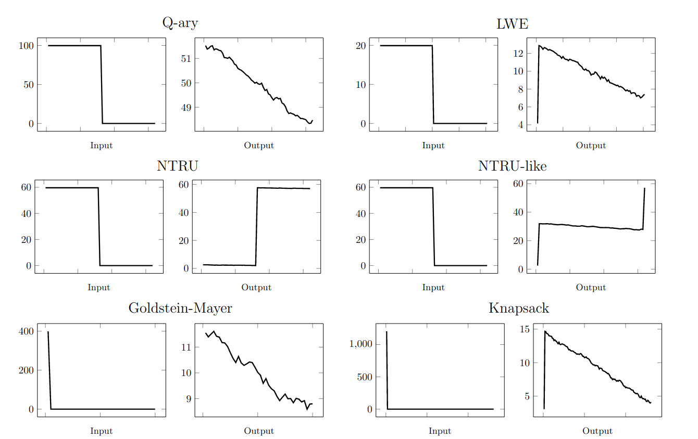
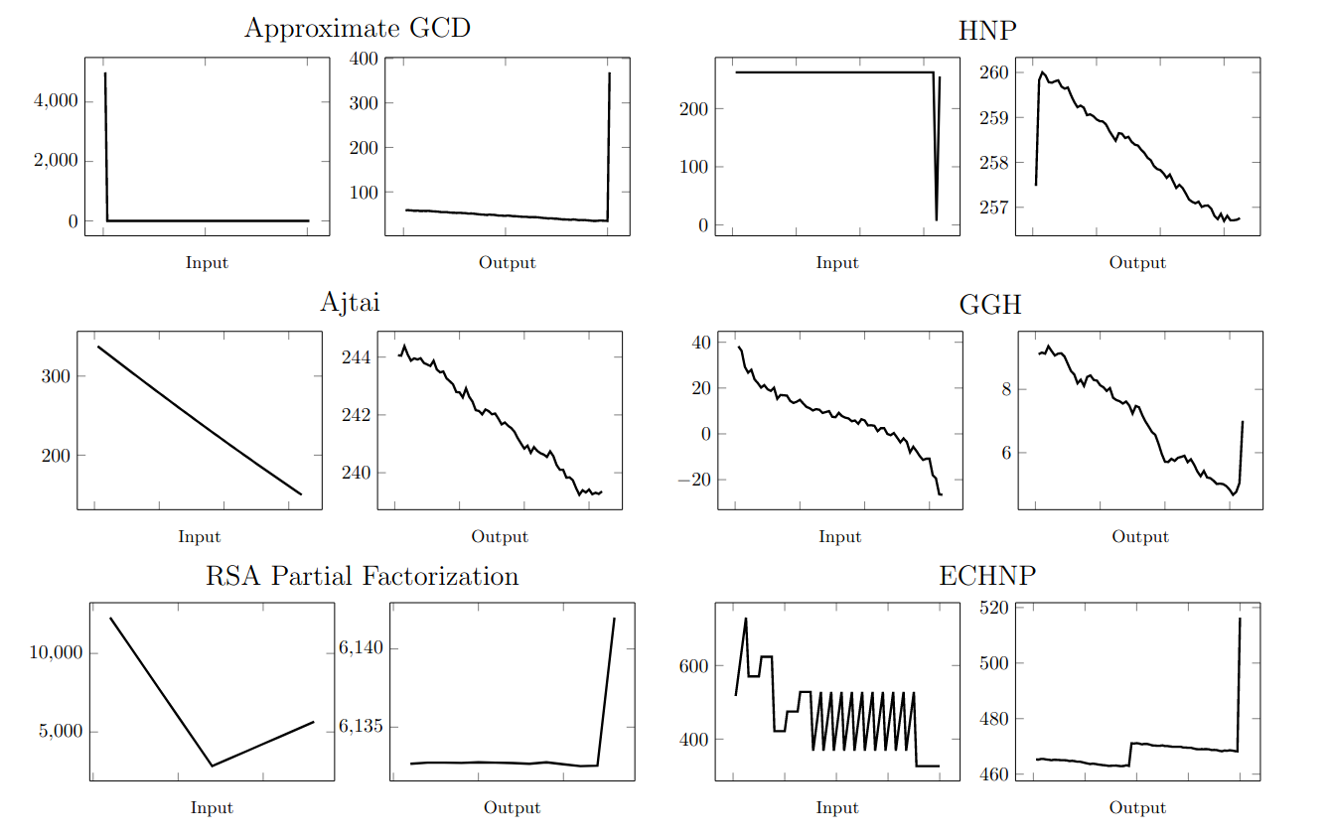
The heuristic of [KEF21] is often wrong
✗
✗
✗
✓
✗
✗
✓
✓
✓
✗
✗
✗

Slide 16
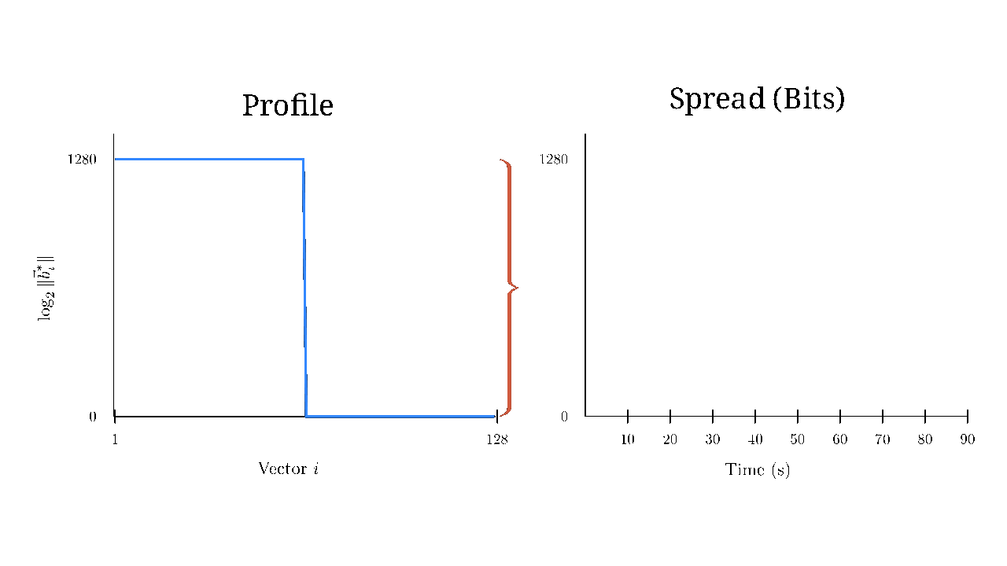
Problems with [KEF21]
The spread (working precision) does not always decrease exponentially quickly.
The profile may have a large increase, which means it has a large spread.
NTRU-like lattice

Slide 17
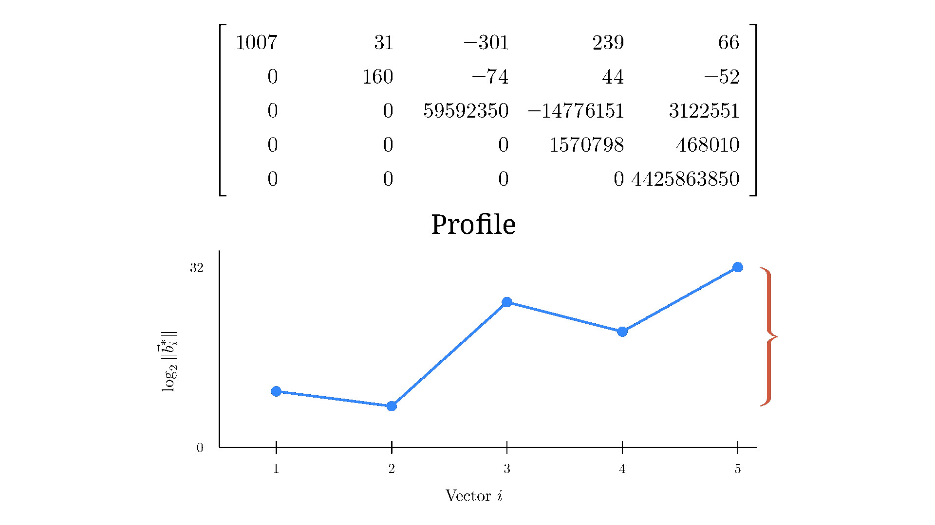
Lattice basis compression [SMSV14]
Scale each vector in a way that does not interfere with lattice reduction.
Geometrically, the scaled lattice has similar properties.
Computationally, this eliminates large increases in the profile.

Slide 18
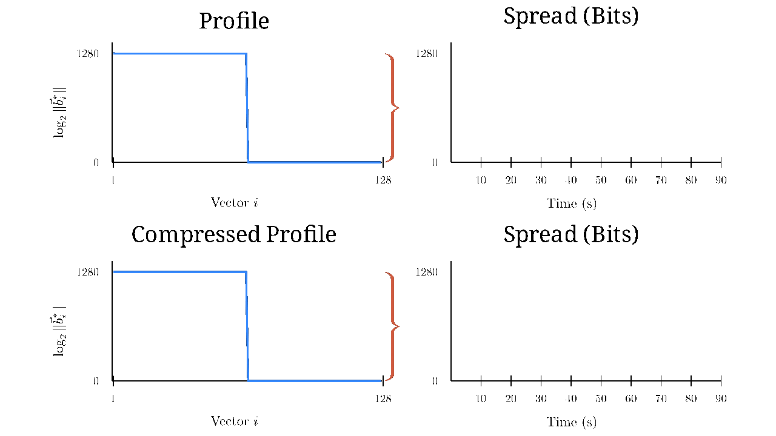
Lattice reduction with iterated compression
Recursively reduce [KEF21] the compressed lattice basis [SMSV14].
Repeat until the compressed spread is small enough.
NTRU-like
without compression
NTRU-like
with compression
Does this strategy always work?

Slide 19
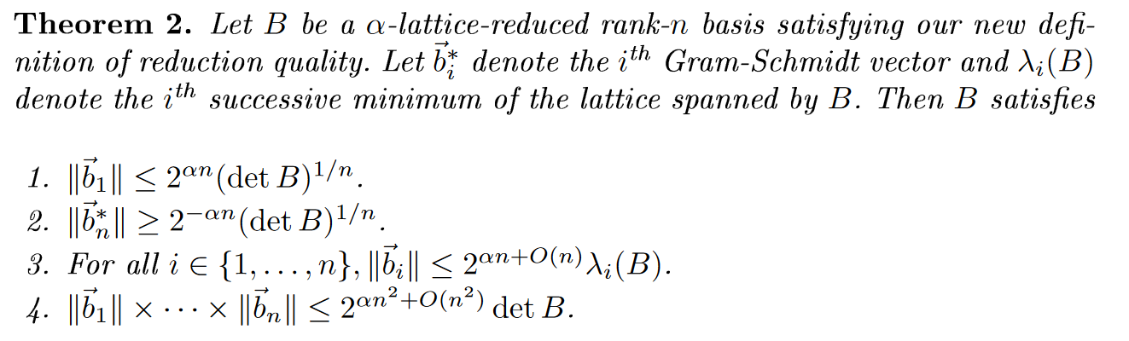
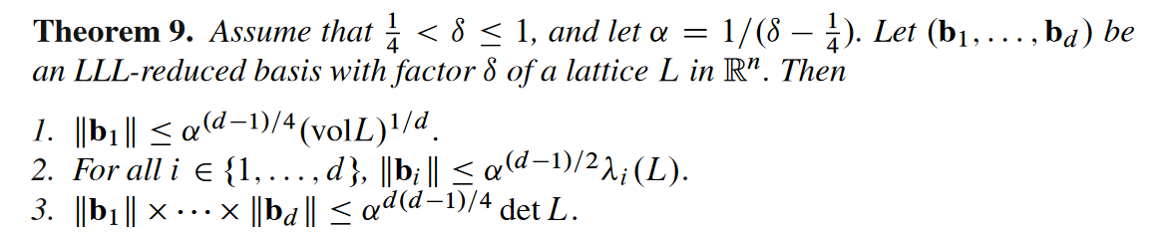
Is our output reduced?
It’s “impractical” for a recursive algorithm to satisfy the Lovász condition [KS01]
Previous recursive algorithms only bound the first returned basis vector
Our output bases have small spread when compressed. This bounds the length and orthogonality of all basis vectors to the same extent as the Lovász condition.
[Ngu10] on LLL-reduced bases
Our reduced bases

Slide 20
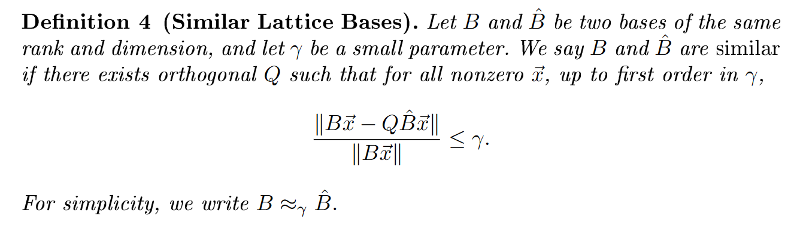
Is our algorithm numerically stable?
Every iteration of compression accumulates new error
Prior perturbation analyses of LLL reduction [CSV12] require the Lovász condition
We analyze a new definition for rounding errors in lattices. Our algorithm is stable.

Slide 21
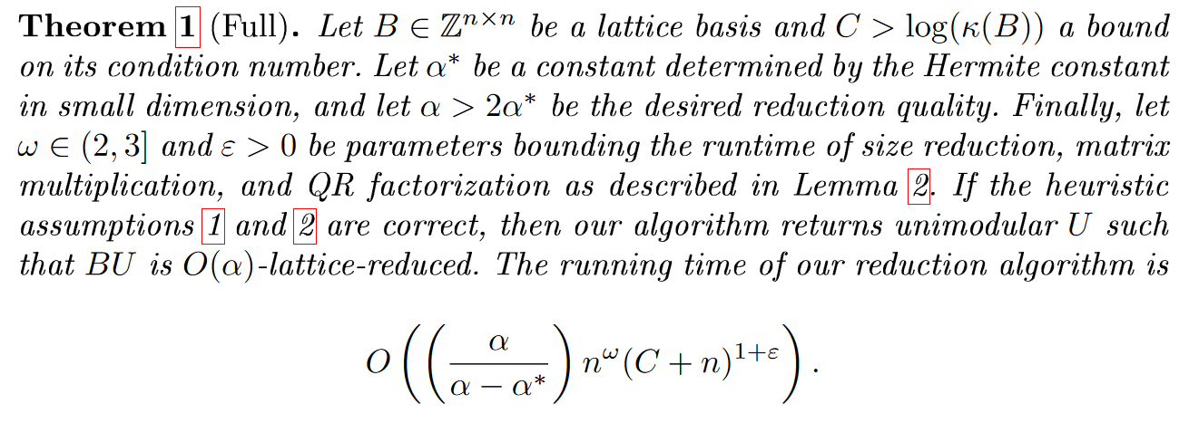
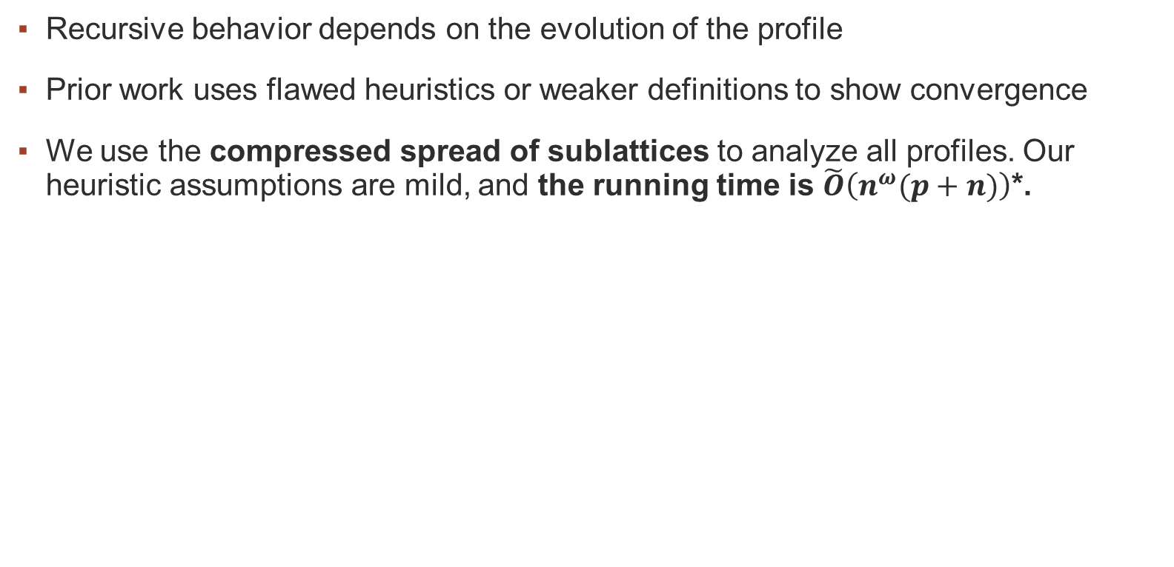
Is our algorithm fast?
Recursive behavior depends on the evolution of the profile
Prior work uses flawed heuristics or weaker definitions to show convergence
We use the compressed spread of sublattices to analyze all profiles. Our heuristic assumptions are mild, and the running time is $\tilde{O}\left(n^{ω}(p+n)\right)$*.
* for inputs with log-condition number bounded by $O(p+n)$, as is the case for size-reduced, triangular bases. For general bases, running time is $\tilde{O}(n^{ω}(\log\left(\left\|B\right\|\left\|B^{−1}\right\|\right)+n))$

Slide 22
Implementation and Experiments

Slide 23
Implementation - flatter
flatter is a library for (f)ast (lat)tice (r)eduction.
Goal: easy-to-use tool like FPLLL
Developed and tested against many cryptanalytic attacks
Recursive leaf nodes use FPLLL’s L² and BKZ implementations
Parallelized by tracking data dependencies in recursive updates
~15000 lines of C++, available at https://github.com/keeganryan/flatter
Implementations planned for FPLLL and Pari/GP

Slide 24
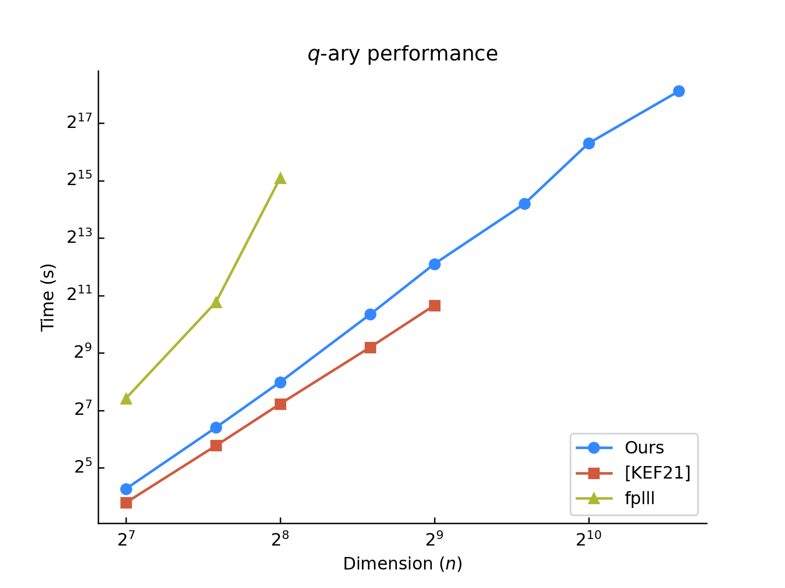
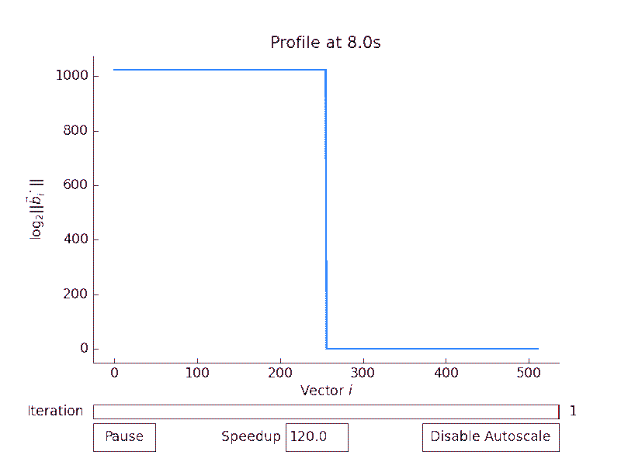
Experiment: $q$-ary lattices
Bases of the form $\left[\begin{matrix}qI_{n/2} & A \\ 0 & I_{n/2}\end{matrix}\right]$ where $p=\left\lceil \log_{2} q\right\rceil ≈2n$
reduced to root Hermite factor 1.02.

Slide 25
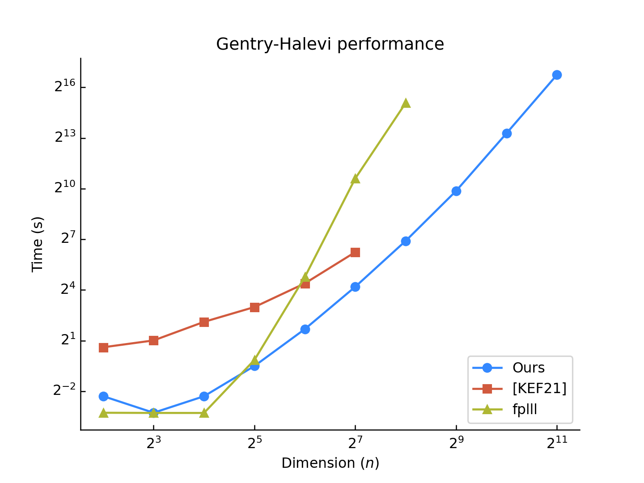
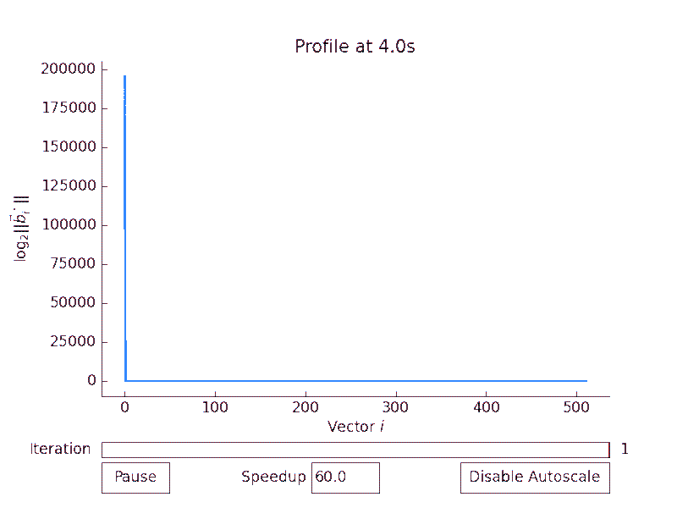
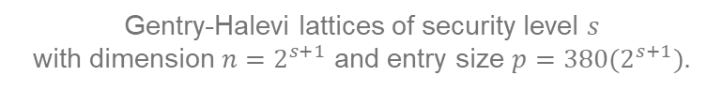
Experiment: Gentry-Halevi FHE [GH11]
Gentry-Halevi lattices of security level $s$
with dimension $n=2^{s+1}$ and entry size $p=380(2^{s+1})$.

Slide 26
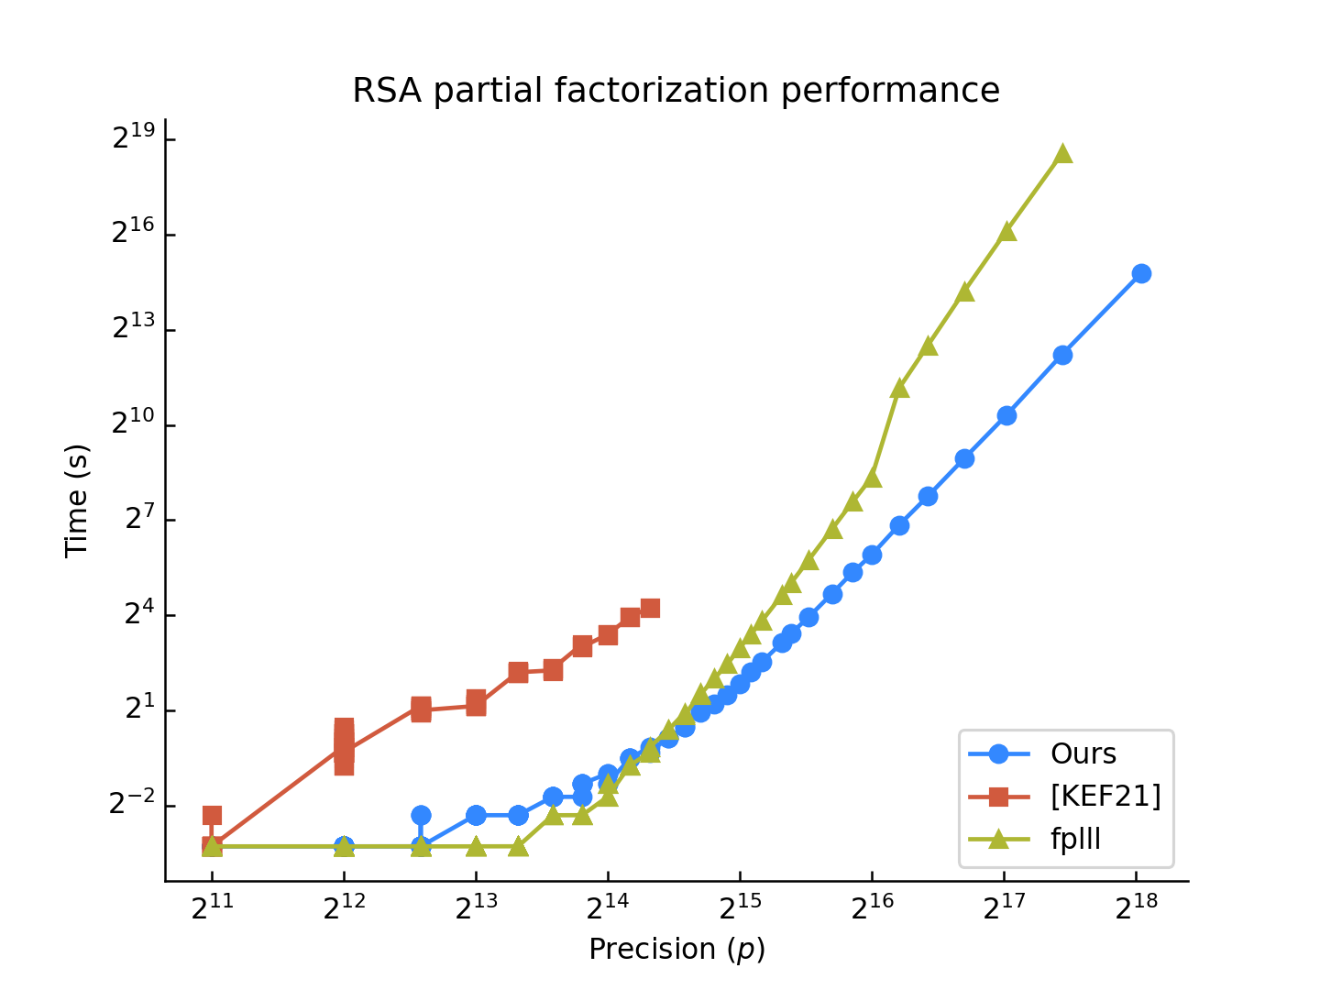
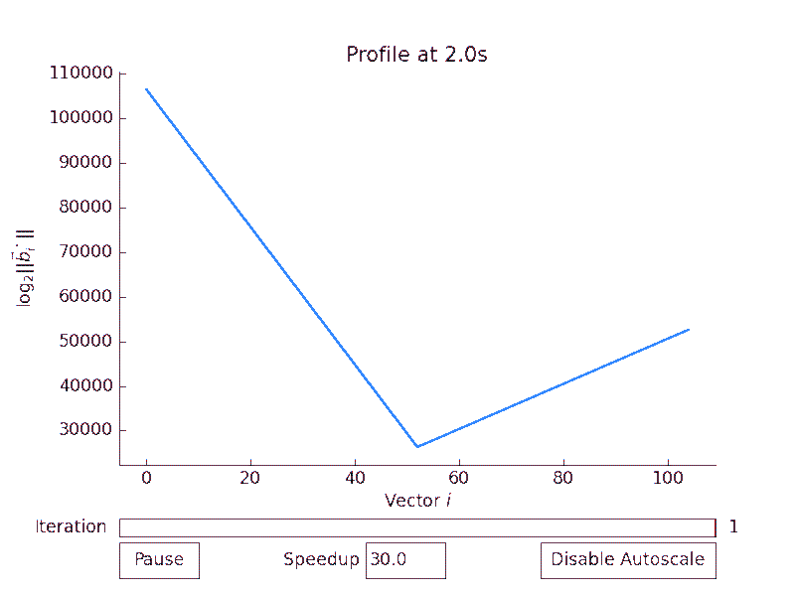
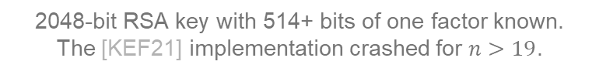
Experiment: RSA partial factorization [How01]
2048-bit RSA key with 514+ bits of one factor known.
The [KEF21] implementation crashed for $n>19$.

Slide 27
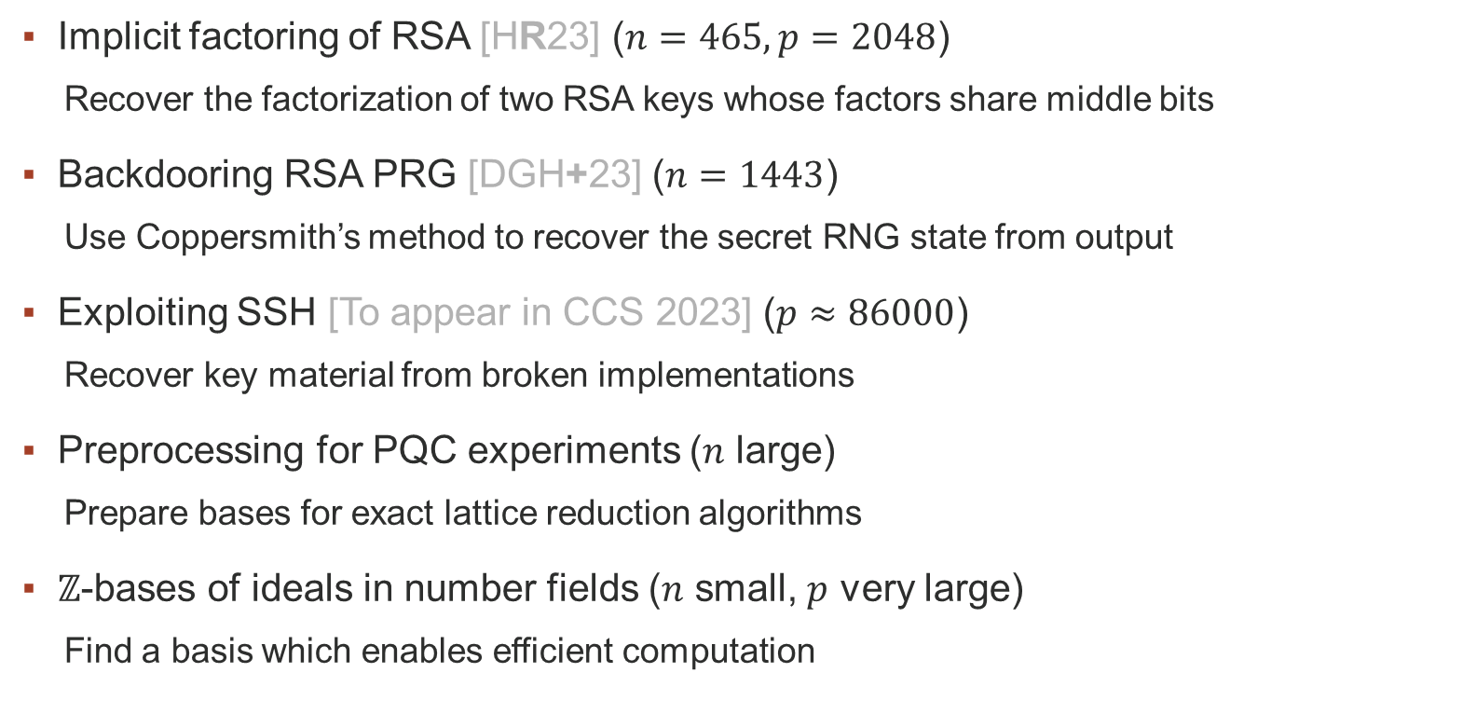
Further applications
Implicit factoring of RSA [HR23] ($n=465, p=2048$)
Recover the factorization of two RSA keys whose factors share middle bits
Backdooring RSA PRG [DGH+23] ($n=1443$)
Use Coppersmith’s method to recover the secret RNG state from output
Exploiting SSH [To appear in CCS 2023] ($p≈86000$)
Recover key material from broken implementations
Preprocessing for PQC experiments ($n$ large)
Prepare bases for exact lattice reduction algorithms
$ℤ$-bases of ideals in number fields ($n$ small, $p$ very large)
Find a basis which enables efficient computation

Slide 28


Thank you
https://ia.cr/2023/237
Keegan Ryan
kryan@ucsd.edu
https://github.com/keeganryan/flatter

Slide 29
References
[CSV12] Chang, X.W., Stehlé, D., Villard, G.: Perturbation analysis of the QR factor R in the context of LLL lattice basis reduction. Mathematics of Computation 81(279), 1487-1511 (2012), https://hal-ens-lyon.archives-ouvertes.fr/ensl-00529425
[CN11] Chen, Y., Nguyen, P.Q.: BKZ 2.0: Better lattice security estimates. In: Lee, D.H., Wang, X. (eds.) ASIACRYPT 2011. LNCS, vol. 7073, pp. 1-20. Springer, Heidelberg (Dec 2011). https://doi.org/10.1007/978-3-642-25385-0_1
[DGH+23] Davis, H., Green, M., Heninger, N., Ryan, K., Suhl, A.: On the possibility of a backdoor in the Micali-Schnorr Generator. Cryptology ePrint Archive, Report 2023/440 (2023), https://eprint.iacr.org/2023/440
[GH11] Gentry, C., Halevi, S.: Implementing Gentry's fully-homomorphic encryption scheme. In: Paterson, K.G. (ed.) EUROCRYPT 2011. LNCS, vol. 6632, pp. 129-148. Springer, Heidelberg (May 2011). https://doi.org/10.1007/978-3-642-20465-4_9
[HR23] Heninger, N., Ryan, K.: The Hidden Number Problem with Small Unknown Multipliers: Cryptanalyzing MEGA in Six Queries and Other Applications. In: Boldyreva, A., Kolesnikov, V. (eds) Public-Key Cryptography - PKC 2023. PKC 2023. Lecture Notes in Computer Science, vol 13940. Springer, Cham. https://doi.org/10.1007/978-3-031-31368-4_6
[How01] Howgrave-Graham, N.: Approximate integer common divisors. In: Silverman, J.H. (ed.) Cryptography and Lattices. pp. 51-66. Springer, Heidelberg (2001)
[KEF21] Kirchner, P., Espitau, T., Fouque, P.A.: Towards faster polynomial-time lattice reduction. In: Malkin, T., Peikert, C. (eds.) CRYPTO 2021, Part II. LNCS, vol. 12826, pp. 760-790. Springer, Heidelberg, Virtual Event (Aug 2021). https://doi.org/10.1007/978-3-030-84245-1_26
[KS01] Koy, H., Schnorr, C.P.: Segment LLL-reduction of lattice bases. In: Silverman, J.H. (ed.) Cryptography and Lattices. pp. 67-80. Springer, Heidelberg (2001)
[LLL82] Lenstra, A.K., Lenstra, H.W., Lovász, L.: Factoring polynomials with rational coefficients. Mathematische Annalen 261(4), 515-534 (Dec 1982). https://doi.org/10.1007/BF01457454
[NS16] Neumaier, A., Stehlé, D.: Faster LLL-type reduction of lattice bases. In: Proceedings of the ACM on International Symposium on Symbolic and Algebraic Computation. p. 373-380. ISSAC '16, Association for Computing Machinery, New York, NY, USA (2016). https://doi.org/10.1145/2930889.2930917
[NS09] Nguyen, P.Q., Stehlé, D.: An LLL algorithm with quadratic complexity. SIAM Journal on Computing 39(3), 874-903 (2009). https://doi.org/10.1137/070705702
[NS01] Nguyen, P.Q., Stern, J.: The Two Faces of Lattices in Cryptology. In: Silverman, J.H. (eds) Cryptography and Lattices. CaLC 2001. Lecture Notes in Computer Science, vol 2146. Springer, Heidelberg (2001). https://doi.org/10.1007/3-540-44670-2_12
[PSZ15] Plantard, T., Susilo, W., Zhang, Z.: LLL for ideal lattices: re-evaluation of the security of Gentry-Halevi's FHE scheme. Designs, Codes and Cryptography 76(2), 325-344 (Aug 2015). https://doi.org/10.1007/s10623-014-9957-1
[SMSV14] Saruchi, Morel, I., Stehlé, D., Villard, G.: LLL reducing with the most significant bits. In: Proceedings of the 39th International Symposium on Symbolic and Algebraic Computation. p. 367-374. ISSAC '14, Association for Computing Machinery, New York, NY, USA (2014). https://doi.org/10.1145/2608628.2608645

